Slide 1
FULL STACK DEVELOPMENT (24SDCS02) MULTI VENDOR MARKETPLACE
Team Members:
Satwika Reddy- 2420030172
Divya Lahari- 2420090041
Sahasra- 2420030459
Vokitha-2420030462
Under the Esteemed Guidance of
Assistant Professor
Dr. Dwarakanath

Slide 2
Abstract
The proposed project aims to develop a modern multi-vendor marketplace platform that enables multiple sellers to list products and buyers to purchase items through a unified cart and split-order system.
The platform includes separate dashboards for admin, sellers, and buyers, ensuring role-based access and management.
The system focuses on enhancing user experience through a professional UI, real-time analytics dashboards, graphical insights, and responsive design.
The solution improves marketplace transparency by providing seller approval workflows, order tracking, dispute management, and commission handling. The frontend redesign ensures enterprise-level usability without modifying backend logic.

Slide 3
Introduction
E-commerce platforms have evolved into multi-vendor ecosystems where multiple sellers operate under a single marketplace.
Traditional implementations often lack structured dashboards, proper analytics, and intuitive UI designs.
This project introduces a modern multi-vendor marketplace that supports buyer-seller interactions, order splitting, seller approvals, and administrative control.
The system provides a professional user interface, graphical analytics, and responsive layouts for improved usability.
The platform enhances operational efficiency while maintaining secure and scalable architecture.

Slide 4
Problem Statement
Existing marketplace UI implementation suffers from the following issues:
Basic and non-professional user interface.
Lack of graphical dashboards and analytics.
Admin panel not clearly displaying approved sellers.
Poor product catalog layout.
No KPI metrics for admin, sellers, or buyers.
Limited responsiveness across devices.
Weak data visualization and reporting
.Inconsistent spacing and typography.
No structured card-based layout.
These limitations reduce usability, scalability, and professional presentation of the platform.

Slide 5
Objectives with Justification
Objective 1: Develop Professional UI Justification: Enhances user experience and improves platform credibility. Objective 2: Implement Admin Analytics Dashboard Justification: Provides insights into seller performance and marketplace activity. Objective 3: Improve Product Catalog Design Justification: Makes browsing intuitive and visually appealing. Objective 4: Add Seller Approval Management Justification: Ensures quality control for marketplace listings. Objective 5: Introduce Graphical Data Visualization Justification: Helps users understand trends quickly. Objective 6: Create Responsive Layout Justification: Ensures usability across mobile, tablet, and desktop devices. Objective 7: Maintain Non-breaking Backend Architecture Justification: Preserves existing business logic and API functionality.

Slide 6
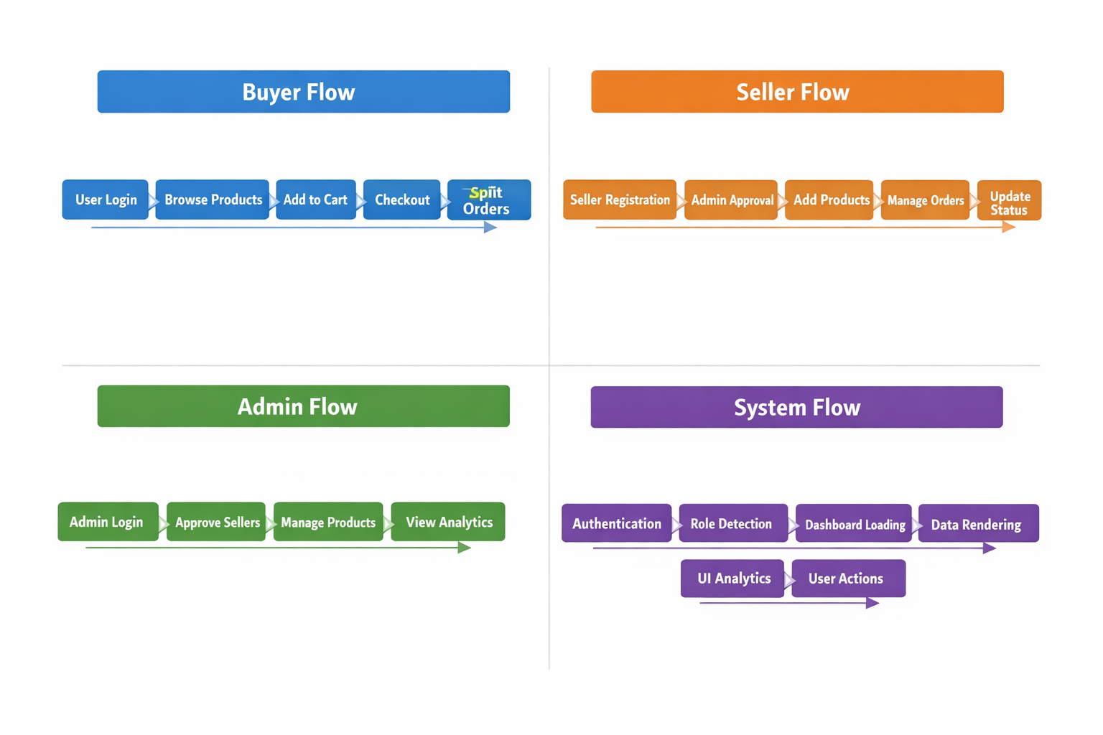
Flow Chart

Slide 7
Modules
Authentication Module: Login Page Register Page Role-based redirection
Admin Module: Admin Dashboard Seller Approval Page Analytics Page Orders Monitoring Dispute Management
Buyer Module : Product Catalog Cart Page Checkout Page Orders Page Disputes Page
Seller Module Seller Dashboard Product Management Orders Management Revenue Analytics

Slide 8
Conclusion
The proposed multi-vendor marketplace UI redesign significantly improves the usability and visual quality of the system. By integrating professional dashboards, graphical analytics, and responsive design, the platform becomes more scalable and user-friendly. The solution maintains the existing backend architecture while delivering a modern enterprise-grade interface. This enhancement ensures better marketplace management, improved buyer-seller interactions, and overall system efficiency

Slide 9
References
References: Nielsen, Jakob. "Usability Engineering", Academic Press Krug, Steve. "Don't Make Me Think", New Riders Material Design Guidelines — Google React Documentation — Meta Material UI Documentation Recharts Data Visualization Library Documentation W3C Web Accessibility Guidelines Multi-vendor Marketplace Architecture Research Papers05:50 PM

Slide 10
Thankyou

